Slide 1
STL In C++

Slide 2
The Standard Template Library (STL) is a set of C++ template classes to provide common programming data structures and functions such as lists, stacks, arrays, etc. It is a library of container classes, algorithms, and iterators
STL has three components
Containers
Containers are used to manage collections of objects of a certain kind. There are several different types of containers like deque, list, vector, map etc.
Algorithms
Algorithms act on containers. They provide the means by which you will perform initialization, sorting, searching, and transforming of the contents of containers.
Iterators
Iterators are used to step through the elements of collections of objects. These collections may be containers or subsets of containers.

Slide 3
STL Container
Containers or container classes store objects and data. There are in total seven standard “first-class” container classes and three container adaptor classes and only seven header files that provide access to these containers or container adaptors.
Sequence Containers: implement data structures which can be accessed in a sequential manner.
vector
list
deque
arrays
forward_list( Introduced in C++11)
Container Adaptors : provide a different interface for sequential containers.
queue
priority_queue
stack

Slide 4
Associative Containers : implement sorted data structures that can be quickly searched (O(log n) complexity).
set
multiset
map
multimap
Unordered Associative Containers : implement unordered data structures that can be quickly searched
unordered_set (Introduced in C++11)
unordered_multiset (Introduced in C++11)
unordered_map (Introduced in C++11)
unordered_multimap

Slide 5
Vector Container
A vector is a sequence container class that implements dynamic array, means size automatically changes when appending elements. A vector stores the elements in contiguous memory locations and allocates the memory as needed at run time.
Difference between vector and array
An array follows static approach, means its size cannot be changed during run time while vector implements dynamic array means it automatically resizes itself when appending elements.

Slide 6
Syntax
Consider a vector 'v1'.
Syntax would be:
vector<object_type> v1;
Example:
vector<int> iv; // create zero-length int vector
vector<char> cv(5); // create 5-element char vector
vector<char> cv(5, 'x'); // initialize a 5-element char vector
vector<int> iv2(iv); // create int vector from an int vector

Slide 7
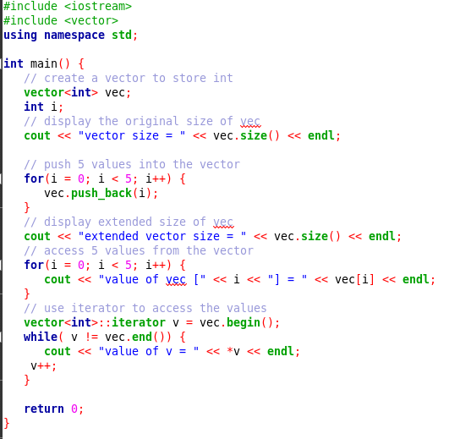
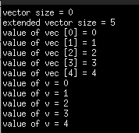

Slide 8
The push_back( ) member function inserts value at the end of the vector, expanding its size as needed.
The size( ) function displays the size of the vector.
The function begin( ) returns an iterator to the start of the vector.
The function end( ) returns an iterator to the end of the vector.

Slide 9
C++ Vector Functions
at() It provides a reference to an element.
back() It gives a reference to the last element.
front() It gives a reference to the first element.
swap() It exchanges the elements between two vectors.
push_back() It adds a new element at the end.
pop_back() It removes a last element from the vector.
empty() It determines whether the vector is empty or not.
insert() It inserts new element at the specified position.

Slide 10
C++ Vector Functions
erase() It deletes the specified element.
resize() It modifies the size of the vector.
clear() It removes all the elements from the vector.
size() It determines a number of elements in the vector.
capacity() It determines the current capacity of the vector.
assign() It assigns new values to the vector.
operator=() It assigns new values to the vector container
.
operator[]() It access a specified element.
end() It refers to the past-lats-element in the vector.

Slide 11
C++ Vector Functions
emplace() It inserts a new element just before the position pos.
emplace_back() It inserts a new element at the end.
rend() It points the element preceding the first element of the vector.
rbegin() It points the last element of the vector.
begin() It points the first element of the vector.
max_size() It determines the maximum size that vector can hold.

Slide 12
C++ Vector Functions
cend() It refers to the past-last-element in the vector.
cbegin() It refers to the first element of the vector.
crbegin() It refers to the last character of the vector.
crend() It refers to the element preceding the first element of the vector.
data() It writes the data of the vector into an array.
shrink_to_fit() It reduces the capacity and makes it equal to the size of the vector.

Slide 13
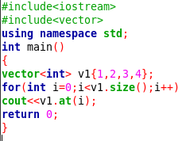
O/P
1234

Slide 14
#include <iostream>
#include <vector>
using namespace std;
int main()
{ vector<int> g1;
for (int i = 1; i <= 5; i++)
g1.push_back(i);
cout << "Output of begin and end: ";
for (auto i = g1.begin(); i != g1.end(); ++i)
cout << *i << " ";
cout << "\nOutput of cbegin and cend: ";
for (auto i = g1.cbegin(); i != g1.cend(); ++i)
cout << *i << " ";
cout << "\nOutput of rbegin and rend: ";
for (auto ir = g1.rbegin(); ir != g1.rend(); ++ir)
cout << *ir << " ";
cout << "\nOutput of crbegin and crend : ";
for (auto ir = g1.crbegin(); ir != g1.crend(); ++ir)
cout << *ir << " ";
return 0;
}
Output:Output of begin and end: 1 2 3 4 5 Output of cbegin and cend: 1 2 3 4 5 Output of rbegin and rend: 5 4 3 2 1 Output of crbegin and crend : 5 4 3 2 1

Slide 15
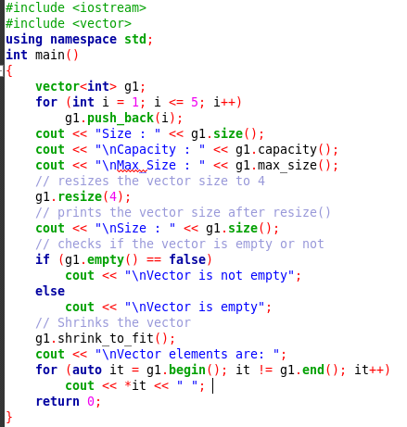


Slide 16
MAP in C++ STL
The map class supports an associative container in which unique keys are mapped with values.
In essence, a key is simply a name that you give to a value. Once a value has been stored, you can retrieve it by using its key.
Thus, in its most general sense, a map is a list of key/value pairs.
The power of a map is that you can look up a value given its key.
For example, you could define a map that uses a person's name as its key and stores that person's telephone number as its value. Associative containers are becoming more popular in programming.
Map can hold only unique keys. Duplicate keys are not allowed.

Slide 17
Consider the example:
Keys(Roll NO) | Names
16030141001 | Akash
16030141002 | Yuvraj
16030141003 | Ashish
16030141004 | Arun
The above example shows a key and value pair. The roll number is the key and each student has a different roll number, hence unique key representing them.

Slide 18
Syntax:
map<key_type , value_type> map_name;
This will create a map with key of type Key_type and value of type value_type.
One thing which is to remembered is that key of a map and corresponding values are always inserted as a pair, you cannot insert only key or just a value in a map.

Slide 19
Some basic functions associated with Map:
begin(): Returns an iterator to the first element in the map.
size(): Returns the number of elements in the map.
empty(): Returns a boolean value indicating whether the map is empty.
insert( pair(key, value)): Adds a new key-value pair to the map.
find(val): Gives the iterator to the element val, if it is found otherwise it returns m.end()
erase(iterator position): Removes the element at the position pointed by the iterator.
erase(const g): Removes the key value g from the map.
clear(): Removes all the elements from the map.

Slide 20
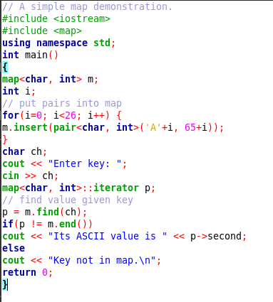

Program

Slide 21
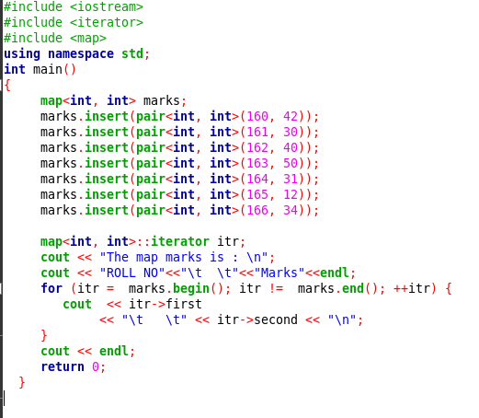
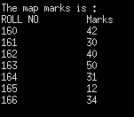
Program

Slide 22
References
C++: The Complete Reference, 4th Edition Herbert Schildt
https://www.javatpoint.com/cpp-vector
https://www.geeksforgeeks.org/vector-in-cpp-stl/
https://www.tutorialspoint.com/cplusplus/cpp_standard_library.htm

